Slide 1
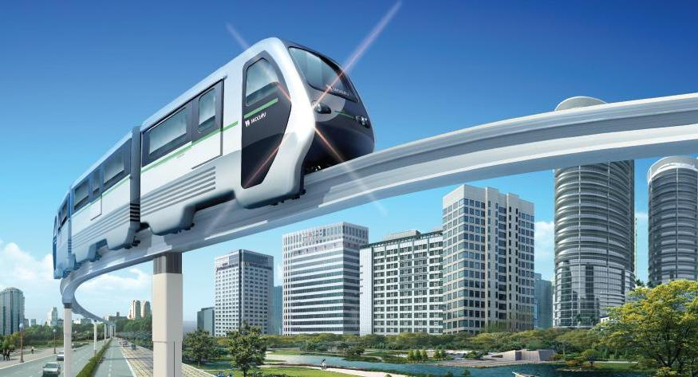

MDS Interface 내용 정리
2012. 01. 30

Slide 2
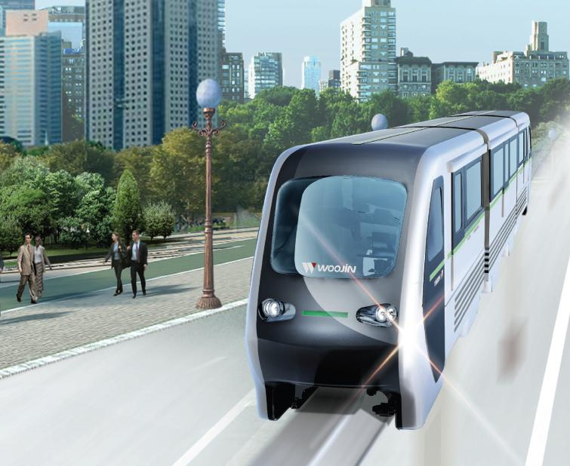
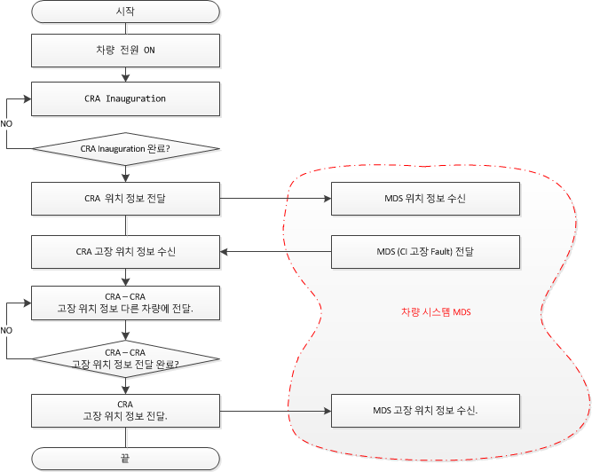
MDS Interface.

Slide 3
추가 견적 내용 정리.
LIC 기능 추가.
-> MDS와 Interface 추가.
MDS 위치 정보 전달 로직 추가.
-> CRA – CRA간 차량 정보 전달 로직에 CI 고장 로직 추가.
-> 각 차량 위치 확인 및 고장 정보 전달 로직 추가.
CCP 화면 구성 추가.
-> 차량 정보 전달 상태를 확인 할 수 있는 UI 추가.

Slide 4
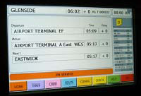

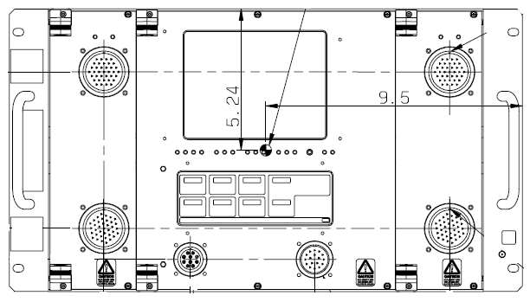
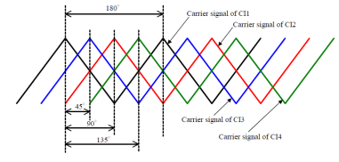
Denver Eagle EMU Project
- CCP 를 통한 데이터 입력 방식 및 피드백 방법 – 1.
CCP (Comm. Control Panel)
Information for car network
(1) Train configuration info.(2 bits)
00 ; 2-cars
01 ; 4-cars
10 ; 6-cars
11 ; 8-cars
(2) C/I position (8 bits = bit 3-10)
10000000 ; no. 1 car
Input Data
피드백 Data
CCP에서 입력된 Data를 CRA는 485 통신 방식으로 입력을 확인 한다.
CRA는 Ci로 Lonworks Net work를 이용하여 Data를 전달 한다.
Ci는 수신한 데이터를 CRA로 Lonworks Networks를 이용하여 피드백 한다.
CRA는 Ci로 부터 받은 피드백 Data를 485 통신 방식으로 CCP로 전달 한다.
SDR : Send Data Request
SD : Send Data
RS 485
CRA
(Comm. Rack A)
CI-SDR
CRA-SD
Lonworks Network
MDS (CDT)
CI-SDR
CRA-SD
Lonworks Network
Converter/Inverter
CI-SDR
CRA-SD

Slide 5
Denver Eagle EMU Project
- CCP 를 통한 데이터 입력 방식 및 피드백 방법 – 2.
CCP (Comm. Control Panel)
CRA는 각 차량에 구성 정보를 수집하고, 각 차량의 열차 번호를 이용하여 차량 번호가 낮은 순서 부터 순차적으로 위치정보를 부여 한다.
CRA는 Ci로 Lonworks Net work를 이용하여 Data를 전달 한다.
Ci는 수신한 데이터를 CRA로 Lonworks Networks를 이용하여 피드백 한다.
CRA는 Ci로 부터 받은 피드백 Data를 485 통신 방식으로 CCP로 전달 한다.
SDR : Send Data Request
SD : Send Data
피드백 Data
RS 485
CRA
(Comm. Rack A)
CRA
(Comm. Rack A)
CI-SDR
CRA-SD
Lonworks Network
차량 구성 정보를 이용하여 CI 위상 제어 정보를 자동으로 전달 한다.
(차량 번호를 이용하여 차량 번호가 낮은 순서대로 차례대로 순서를 설정 한다.)
MDS (CDT)
CI-SDR
CRA-SD
Lonworks Network
Converter/Inverter
CI-SDR
CRA-SD

Slide 6
Denver Eagle EMU Project
Phase Shift _ 8-cars
CRA(PA) – MDS – Converter/Inverter, (8) When a Converter/Inverter is Failed
- CI 고장 정보를 다른 차량에 전달 하는데 MAX 90초가 소요된다.
CCP (Comm. Control Panel)
CCP (Comm. Control Panel)
CCP (Comm. Control Panel)
CCP (Comm. Control Panel)
RS 485
RS 485
RS 485
RS 485
CRA
(Comm. Rack A)
CRA
(Comm. Rack A)
CRA
(Comm. Rack A)
CRA
(Comm. Rack A)
Fault
Data
Fault
Data
Fault
Data
Fault
Data
Lonworks Network
MDS (CDT)
CI 고장 정보를 다른 차량에 전송한다.
Fault
Data
전체 차량 고장 정보 전달에 최대 90초가 걸린다.
Lonworks Network
Excessive Noise
Converter/Inverter
Phase Shift (degree)
0
X
60
120
0
90
45
135

Slide 7
Denver Eagle EMU Project
Phase Shift _ 2-cars
- CRA(PA) – MDS – Converter/Inverter, (1) when START UP
CCP (Comm. Control Panel)
CCP (Comm. Control Panel)
Information for car network
(1) Train configuration info.(2 bits)
00 ; 2-cars
01 ; 4-cars
10 ; 6-cars
11 ; 8-cars
(2) C/I position (8 bits = bit 3-10)
10000000 ; no. 1 car
피드백 Data
Input Data
피드백 Data
RS 485
RS 485
CRA MA
(Comm. Rack A)
RS-485
CRA MB
(Comm. Rack A)
RS-485
CI-SDR
CRA-SD
CI-SDR
CRA-SD
Lonworks Network
Lonworks Network
MDS (CDT)
MDS (CDT)
CI-SDR
CRA-SD
CI-SDR
CRA-SD
Lonworks Network
Lonworks Network
Converter/Inverter
Converter/Inverter
CI-SDR
CRA-SD
CI-SDR
CRA-SD
Phase Shift (degree)
0
90
--
--
--
--
--
--

Slide 8
Denver Eagle EMU Project
Phase Shift _ 2-cars
- CRA(PA) – MDS – Converter/Inverter, (2) When a Converter/Inverter is Failed
CCP (Comm. Control Panel)
RS 485
RS 485
CRA
(Comm. Rack A)
RS-485
CRA
(Comm. Rack A)
RS-485
Lonworks Network
Lonworks Network
MDS (CDT)
MDS (CDT)
Lonworks Network
Lonworks Network
Excessive Noise
FAILURE
Converter/Inverter
Converter/Inverter
Information for car network
Failure of Converter/Inverter
10000000 ; no. 1 car fault
Phase Shift (degree)
X
90
--
--
--
--
--
--

Slide 9
Denver Eagle EMU Project
Phase Shift _ 4-cars
- CRA(PA) – MDS – Converter/Inverter, (3) when START UP
CCP (Comm. Control Panel)
CCP (Comm. Control Panel)
Information for car network
(1) Train configuration info.(2 bits)
00 ; 2-cars
01 ; 4-cars
10 ; 6-cars
11 ; 8-cars
(2) C/I position (8 bits = bit 3-10)
00100000 ; no. 3 car
RS 485
RS 485
RS-485
CRA
(Comm. Rack A)
RS-485
CRA
(Comm. Rack A)
RS-485
RS-485
Lonworks Network
Lonworks Network
MDS (CDT)
MDS (CDT)
Lonworks Network
Lonworks Network
Converter/Inverter
Converter/Inverter
Phase Shift (degree)
0
90
45
135
--
--
--
--

Slide 10
Denver Eagle EMU Project
Phase Shift _ 4-cars
- CRA(PA) – MDS – Converter/Inverter, (4) When a Converter/Inverter is Failed
CCP (Comm. Control Panel)
CCP (Comm. Control Panel)
RS 485
RS 485
RS-485
CRA
(Comm. Rack A)
RS-485
CRA
(Comm. Rack A)
RS-485
RS-485
Lonworks Network
Lonworks Network
MDS (CDT)
MDS (CDT)
Lonworks Network
Lonworks Network
Converter/Inverter
Converter/Inverter
Information for car network
Failure of Converter/Inverter
00100000 ; no. 3 car fault
Phase Shift (degree)
0
60
X
120
--
--
--
--

Slide 11
Denver Eagle EMU Project
Phase Shift _ 6-cars
- CRA(PA) – MDS – Converter/Inverter, (5) when START UP
CCP (Comm. Control Panel)
CCP (Comm. Control Panel)
Information for car network
(1) Train configuration info.(2 bits)
00 ; 2-cars
01 ; 4-cars
10 ; 6-cars
11 ; 8-cars
(2) C/I position (8 bits = bit 3-10)
00100000 ; no. 3 car
RS 485
RS 485
RS-485
CRA
(Comm. Rack A)
RS-485
CRA
(Comm. Rack A)
RS-485
RS-485
Lonworks Network
Lonworks Network
MDS (CDT)
MDS (CDT)
Lonworks Network
Lonworks Network
Converter/Inverter
Converter/Inverter
Phase Shift (degree)
0
45
90
135
0
90
--
--

Slide 12
Denver Eagle EMU Project
Phase Shift _ 6-cars
- CRA(PA) – MDS – Converter/Inverter, (6) When a Converter/Inverter is Failed
CCP (Comm. Control Panel)
CCP (Comm. Control Panel)
RS 485
RS 485
RS-485
CRA
(Comm. Rack A)
RS-485
CRA
(Comm. Rack A)
RS-485
RS-485
Lonworks Network
Lonworks Network
MDS (CDT)
MDS (CDT)
Lonworks Network
Lonworks Network
Converter/Inverter
Converter/Inverter
Information for car network
Failure of Converter/Inverter
00100000 ; no. 3 car fault
Phase Shift (degree)
0
60
X
120
0
90
--
--

Slide 13
Denver Eagle EMU Project
Phase Shift _ 8-cars
- CRA(PA) – MDS – Converter/Inverter, (7) when START UP
CCP (Comm. Control Panel)
CCP (Comm. Control Panel)
Information for car network
(1) Train configuration info.(2 bits)
00 ; 2-cars
01 ; 4-cars
10 ; 6-cars
11 ; 8-cars
(2) C/I position (8 bits = bit 3-10)
00100000 ; no. 3 car
RS 485
RS 485
RS-485
CRA
(Comm. Rack A)
RS-485
CRA
(Comm. Rack A)
RS-485
RS-485
Lonworks Network
Lonworks Network
MDS (CDT)
MDS (CDT)
Lonworks Network
Lonworks Network
Converter/Inverter
Converter/Inverter
Phase Shift (degree)
0
90
45
135
0
90
45
135

Slide 14
Denver Eagle EMU Project
Phase Shift _ 8-cars
- CRA(PA) – MDS – Converter/Inverter, (8) When a Converter/Inverter is Failed
CCP (Comm. Control Panel)
CCP (Comm. Control Panel)
RS 485
RS 485
RS-485
CRA
(Comm. Rack A)
RS-485
CRA
(Comm. Rack A)
RS-485
RS-485
Lonworks Network
Lonworks Network
MDS (CDT)
MDS (CDT)
Lonworks Network
Lonworks Network
Converter/Inverter
Converter/Inverter
Information for car network
Failure of Converter/Inverter
00100000 ; no. 3 car fault
Phase Shift (degree)
0
60
X
120
0
90
45
135

